Slide 1

CURS Deleted File Recovery Research Project
By Andrew Meyer, Quinton Currier, Sankar Roy

Slide 2
Why is file recovery important?
A growing digital world means new possibilities of using and manipulating data
More and more crimes are happening online, and criminals work to hide and delete data that can identify or help persecute them
Criminal cases are relying more on software that can reliably recover data that has been deleted and used in court to prove innocence or guilt

Slide 3
What makes a Deleted File Recovery tool reliable?
National Institute of Standards and Technology(NIST) has a project (CFTT) that specializes in “ensuring the reliability of computer forensics tools” * for a variety of categories.
The CFTT has created 4 Core standard that a software should meet to be considered reliable and provide accurate and useful results.
DFR-CR-01 The tool shall identify all Deleted File System Object entries accessible in residual metadata

Slide 4
Process
We tested a variety of tools and file systems to cover as many scenarios as possible.
Autopsy, Testdisk, and Recuva are all free software that can be downloaded by anyone. Magnet Axiom and FTK Imager are premium softwares that requires licenses.
There are many different file systems that are used by different operating systems.
FAT and NTFS are the most common in Windows computer operating systems and the ones we tested with during the time frame.

Slide 5
Process
To test each tool consistently, we used small flash drives to create different scenarios of files being created and deleted.
We were able to create 10 different scenarios of how the files were being created, deleted, written over, and separated.
We then created a raw image of the drive where we captured all the information (including any deleted files) and ran them through the different softwares.

Slide 6
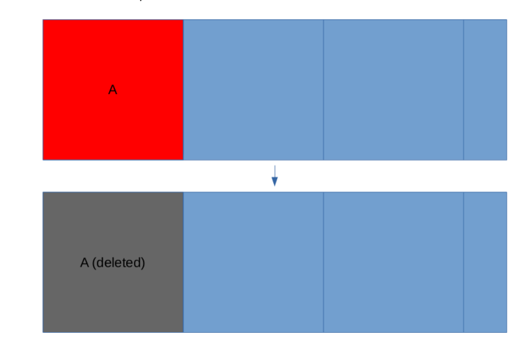
Test Cases
Test Case 1: File A was created, then deleted.
This case is an example of a standard deletion of a file. Either on purpose or by accident

Slide 7
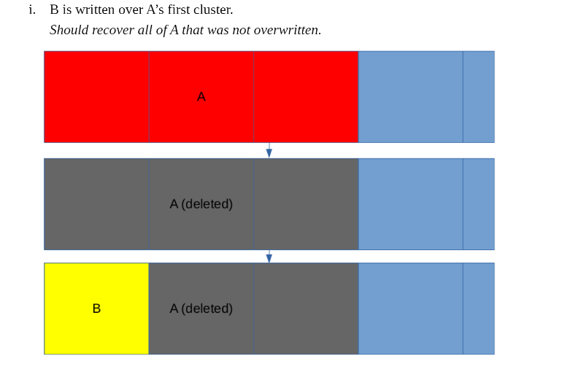
Test Cases
Test Case 4(i): File A was created, File A was deleted, a smaller file B was created starting where A would have been
This case is an example of a file being deleted, then someone trying to overwrite the data to to ensure it cannot be recovered

Slide 8
Lessons Learned - Tools
Initially we were going to use an open source software PhotoRec as one of our tools.
However, we changed it to Testdisk after we realized the Autopsy used part of PhotoRec in it’s file recovery process. We wanted to make sure we had as much variety in tools as possible without any cross dependices

Slide 9
Lessons Learned - Process
When creating files, we originally did not worry about much of the details other than the contents and what was being recovered.
However, with Magnet Axiom, it was unable to identify any of the files we created in our test cases because none of them had file extensions. (file1 vs. file1.txt)
We were able to recreate the test cases with the file extension added and rerun the tests for Magnet Axiom

Slide 10
Results

Slide 11
Results

Slide 12
Results

Slide 13
Future possibilities
More file types and extensions (.jpg, .png, .gif, .mp4, .mp3, etc.)
Less common test cases (Run data wipe tools first, larger files, etc.)
Run tests through more tools (Encase, FTK, other premium tools)

Slide 14
Outcomes
Because of this project we were able to provide the following:
Lessons plans to the BGSU CS Department
Assist with Digital Forensics Workshop hosted by BGSU CS
Work with Magnet Axiom software developers about identifying file without extensions

